Slide 1
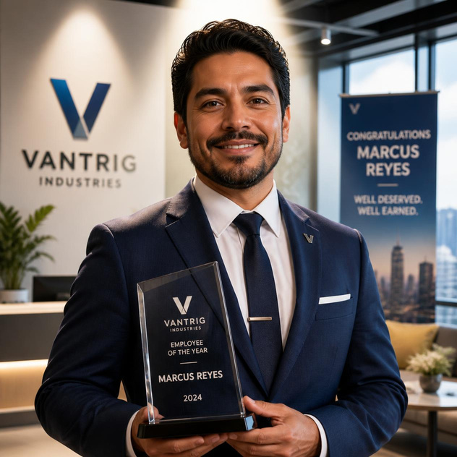

Marcus Reyes
Manager, VantriG Industries
Superpower: Operations Guru
Employee of the Year
Wife: Monica
Twins, age 8: Lilly & Jackson
Dogs: Millie & MArley

